Slide 1
Software Engineering
Binarization Filter
Name: Suraj Bharadwaj
Mr Number: 1224681
Date: 30.04.2018

Slide 2
Introduction:
Binarization is the process of converting a pixel image to a binary image.
Separate the foreground out from the background of an image .
Binary image is a combination of only two possible values
Binarization can be used in recognizing text and symbols, e.g. document processing.
The algorithms divide into two categories:
a) Global Binarization- Uses single threshold value for whole image.
b) Local Binarization-The threshold value is calculated locally pixel by pixel or
region by region.

Slide 3
IMPLEMENTATION:
STEP 1: Take Image from user
STEP 2: Convert image into Greyscale based on
threshold(global or dynamic)
STEP 3: Apply filter to remove noise(convolutional or median filter)
STEP 4: Integrate with Learning API

Slide 4
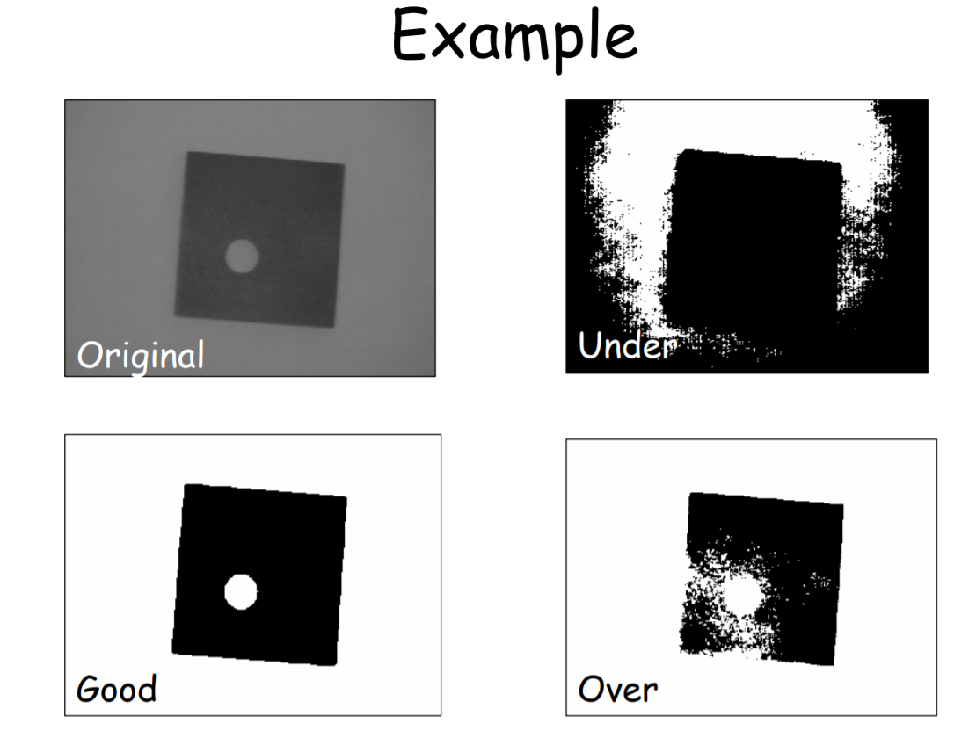

GLobal Thresholding:
Choose a global threshold, T
Pass in logic operator

Slide 5
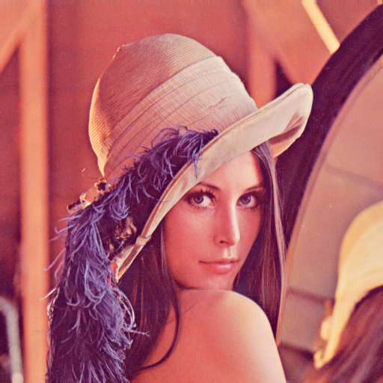
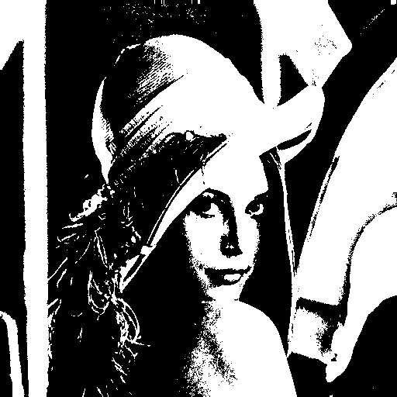
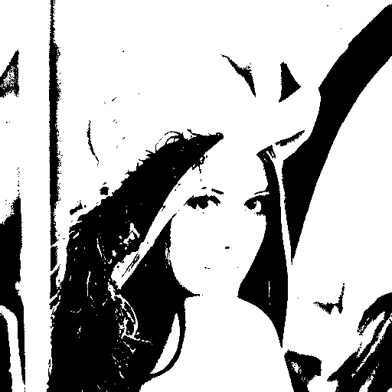
LOCAL THRESHOLDING:
Step through all intensity levels in histogram
-Set T (Threshold) to current
intensity level
– Compute between-class
variance
Desired threshold level reduces between-class to a minimum
Original image Fixed threshold(127) Otsu Threshold (161)

Slide 6
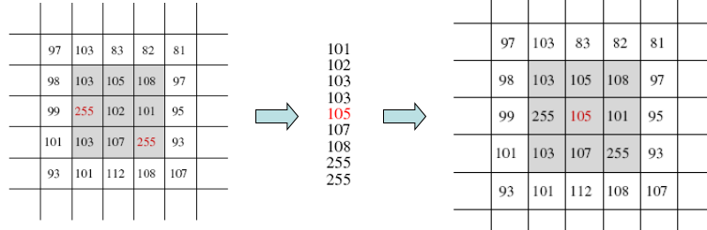
Median filter:
The median filter is a nonlinear digital filtering technique, often used to remove noise. Preserves edges while removing noise.
Step 1:For each neighbor in image, sliding the window
Step 2:Sort pixel values
Step 3:Set the center pixel to the median

Slide 7
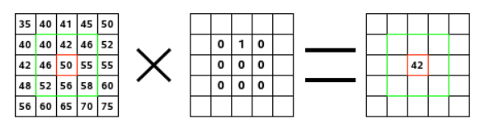
Convolution Filter:
Why convolve an image?-Blurring, Smoothing, Edge Detection, Sharpening . The resulting filtered images still bears a relation to the input source image.
The filter is described by a n x m discrete convolution mask
The filter read successively, from left to right and from top to bottom, all the pixels of the kernel action area. It multiplied the value of each of them by the kernel corresponding value and added results.
The initial pixel has become 42: (40*0)+(42*1)+(46*0) + (46*0)+(50*0)+(55*0) + (52*0)+(56*0)+(58*0) = 42
Image matrix Kernel convolution
result

Slide 8
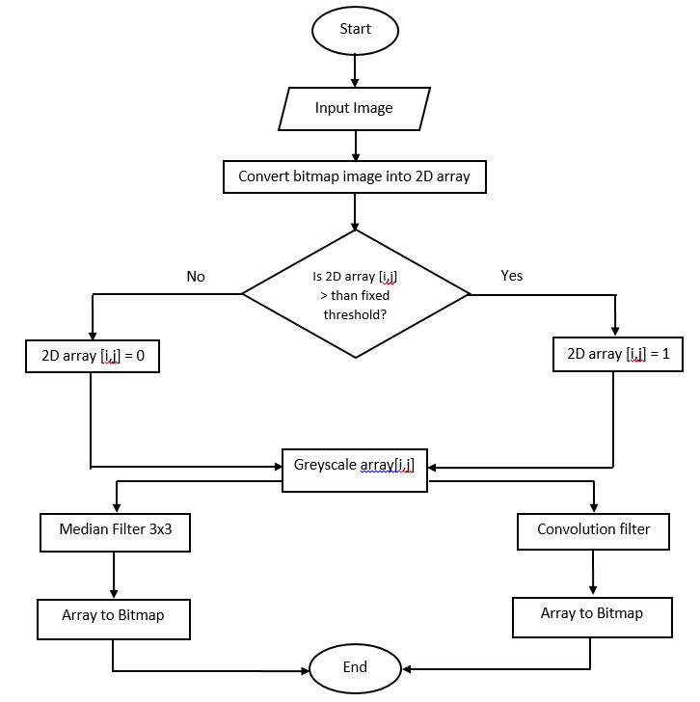
Global Threshold Binarization Filter (Fixed Threshold):Flowchart

Slide 9
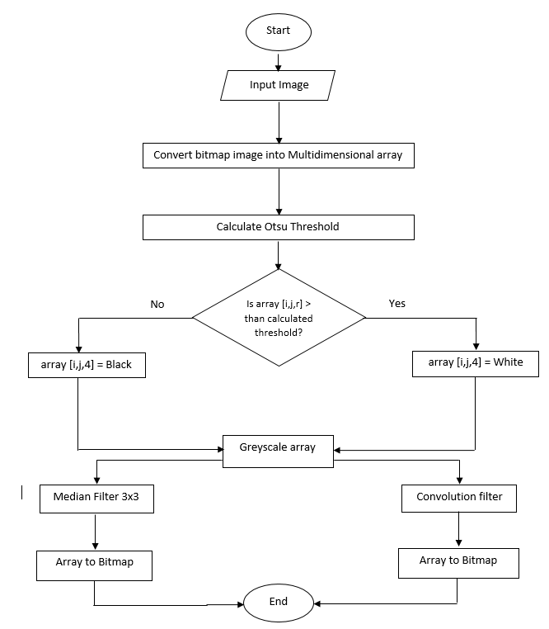
Local Threshold Binarization Filter (Dynamic Threshold): Flowchart

Slide 10
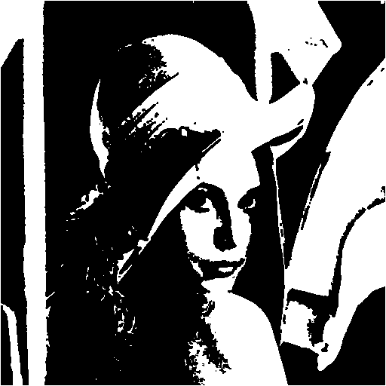
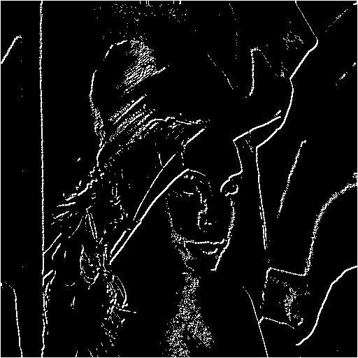
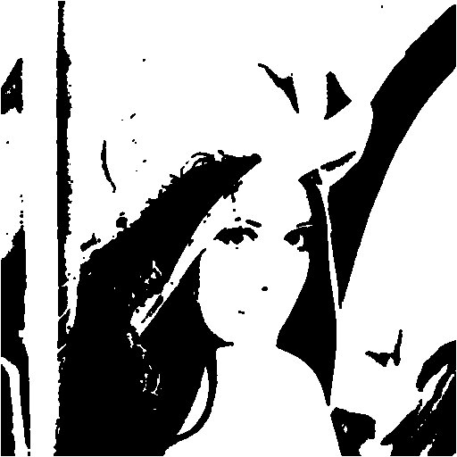
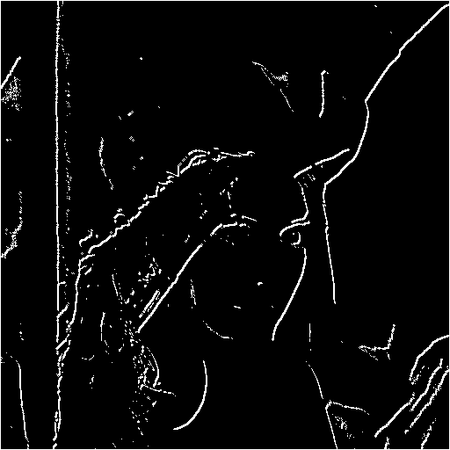
Outputs:
Binarization Filter using fixed threshold:
Original Image Binarized Fixed Threshold Image Median filter Output Convolution Filter Output
Binarization Filter using Dynamic threshold:
Original Image Binarized Dynamic Threshold Image Median filter Output Convolution Filter Output

Slide 11
References:
https://softwarebydefault.com/2013/05/18/image-median-filter/
https://www.codeproject.com/Articles/16859/AForge-NET-open-source-framework
https://www.markschulze.net/java/meanmed.html
https://www.researchgate.net/publication/318107356_A_selectional_aut
http://www.aforgenet.com/framework/features/binarization.htmlo-encoder_approach_for_document_image_binarization

Slide 12
Thank you

